Slide 1

Statistical software and ecology: Paths and impediments for scientific progress and thought
Aaron M. Ellison
Harvard University, Harvard Forest

Slide 2
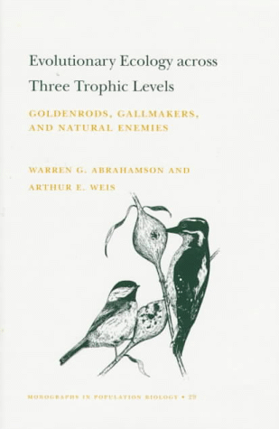


Slide 3
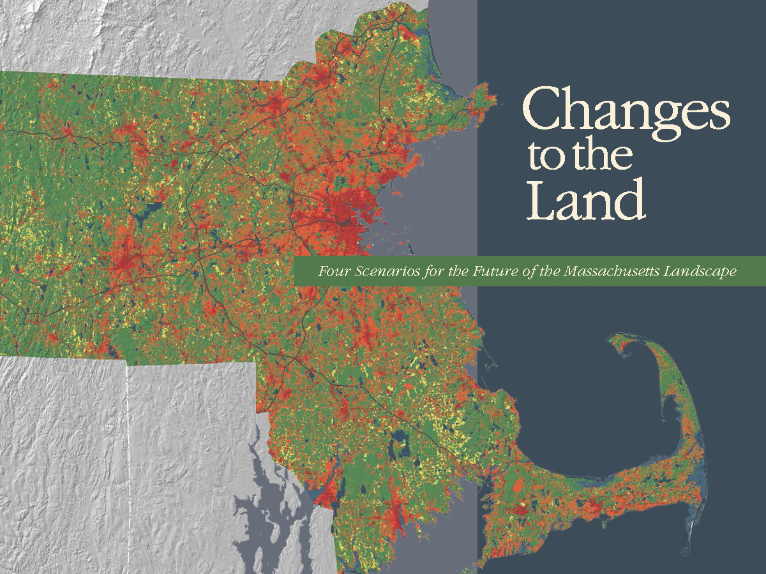


Slide 4
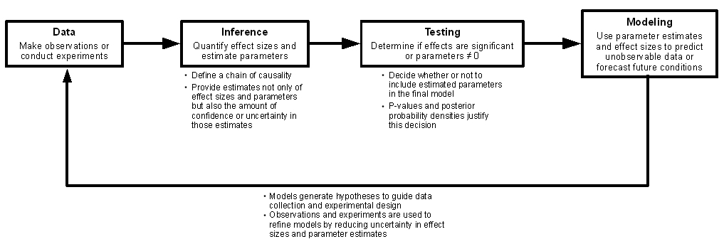

Slide 7


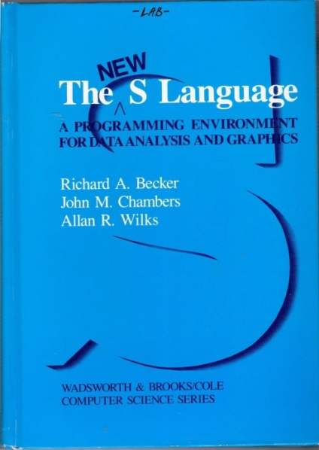

Slide 8



Slide 10
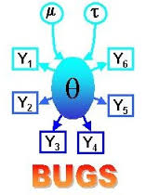
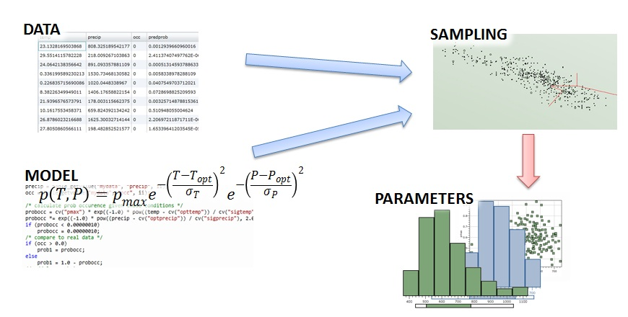
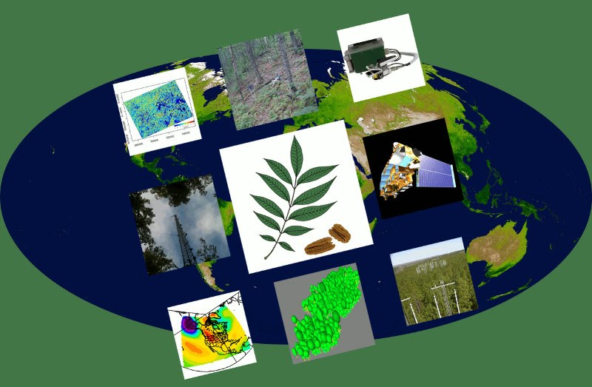




pymc
PyStan
pomp
(requires methods, mvtnorm, subplex, deSolve)
rjags
(requires coda)
rINLA
(requires sp;
recommends numDeriv, Rgraphviz, fields, rgl, mvtnorm, multicore, pixmap)
rstan
(requires Rcpp, Inline; also C++ compiler)
Notes:
Filzbach: C++; DART: Fortran 90, netCDF library

Slide 11
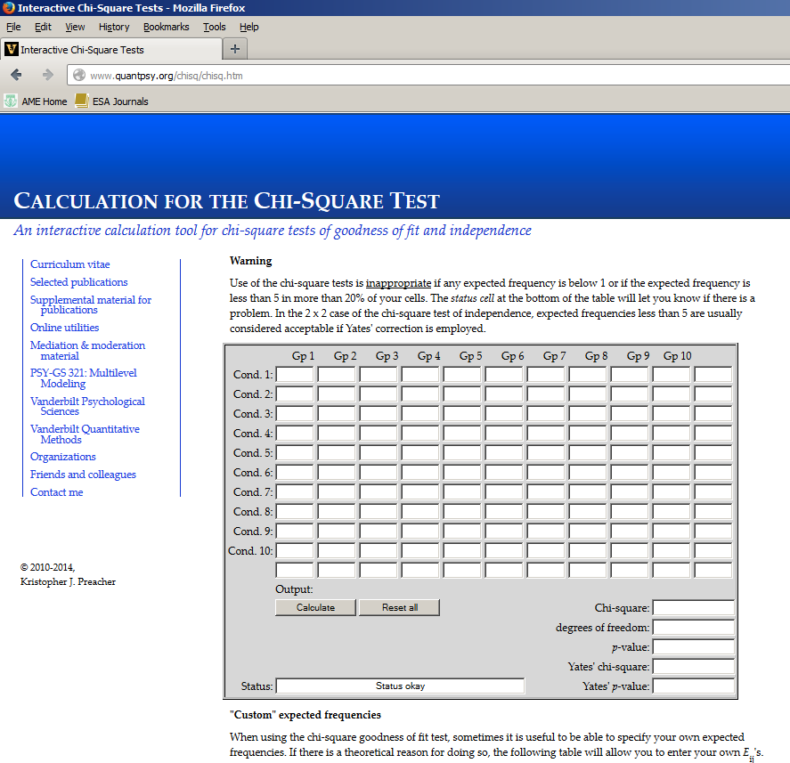
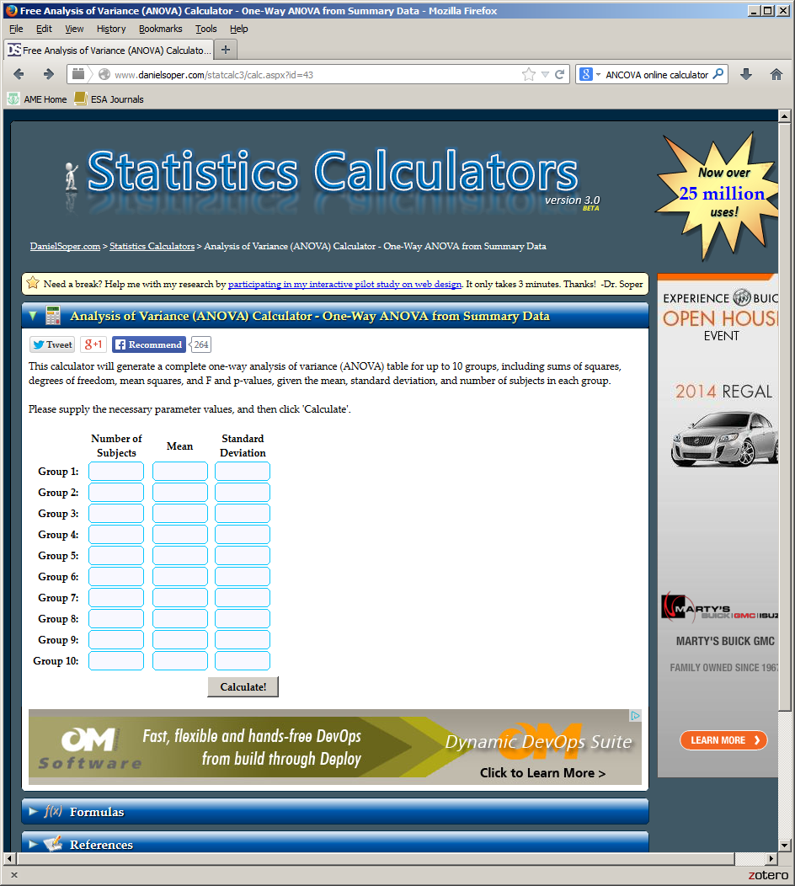
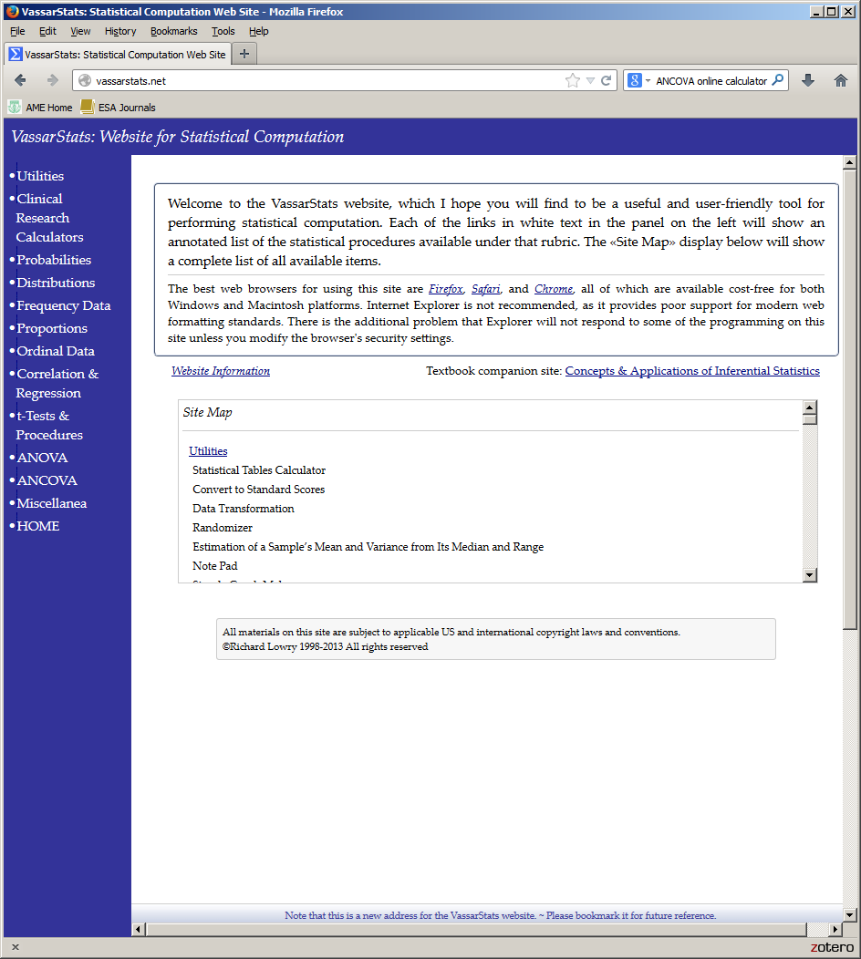

Slide 12
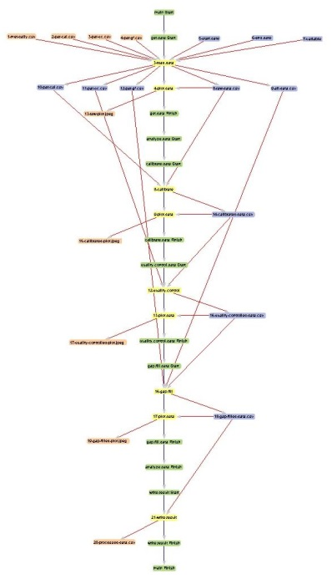

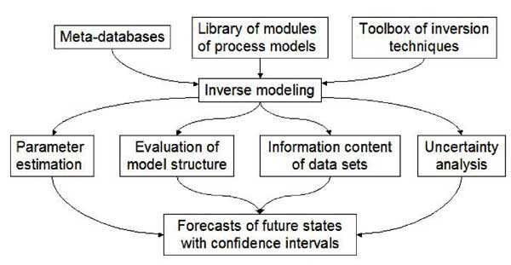


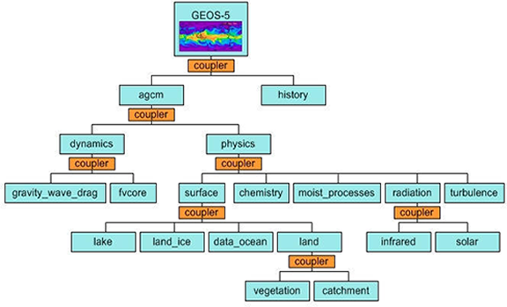
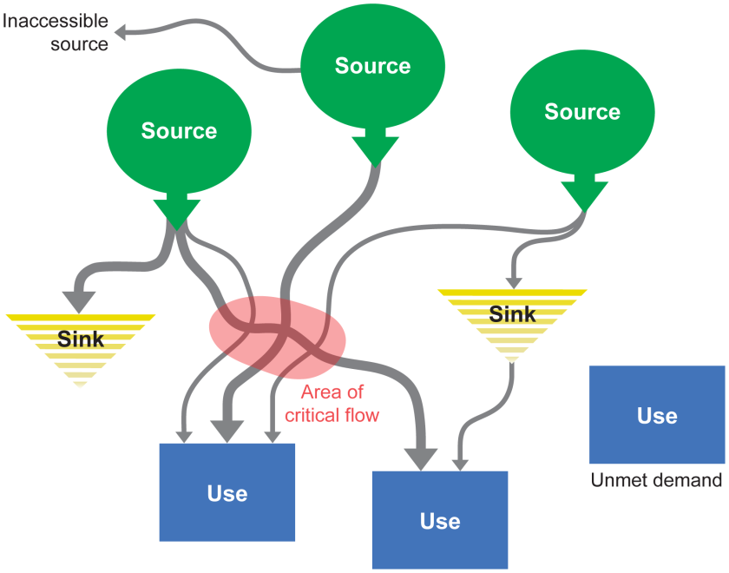
Notes:
ARIES, Ecopad, ESMF

Slide 13
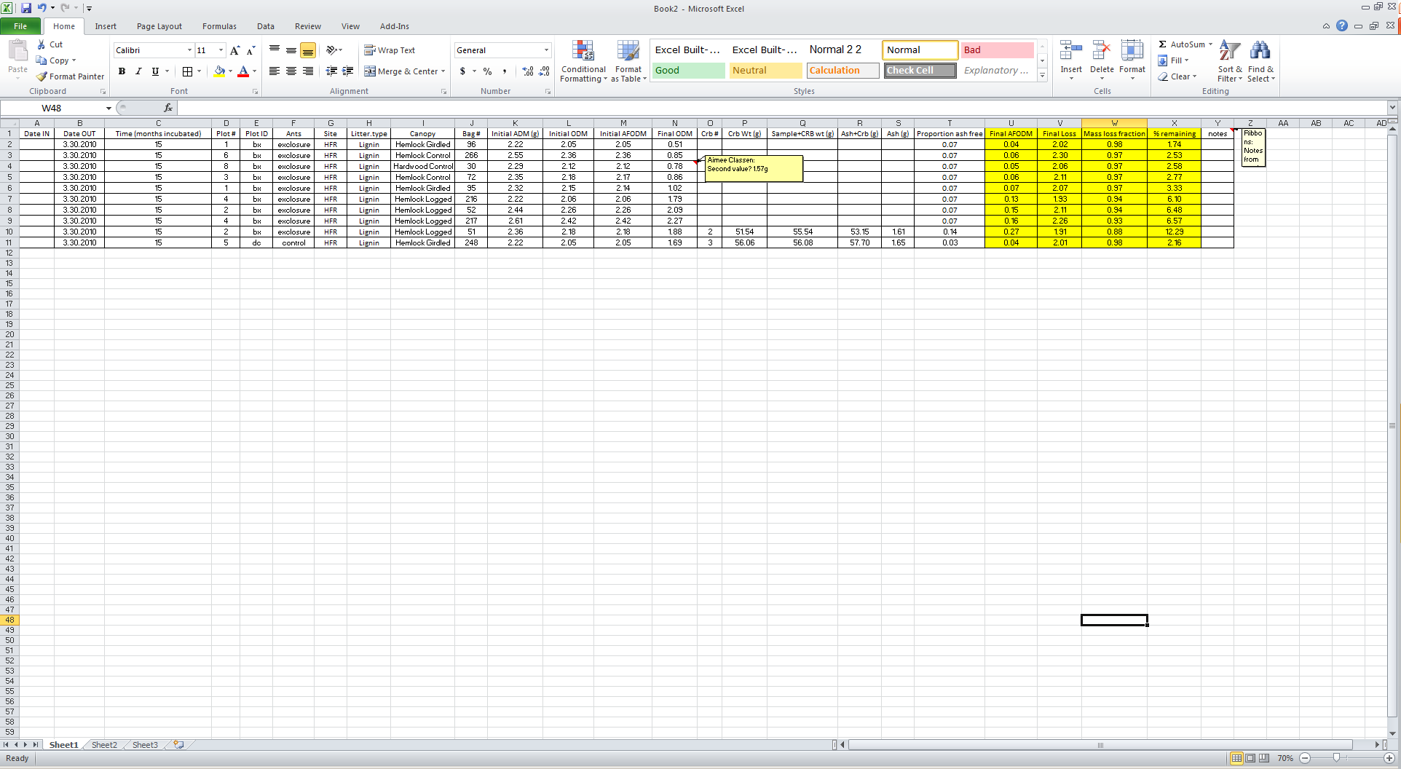
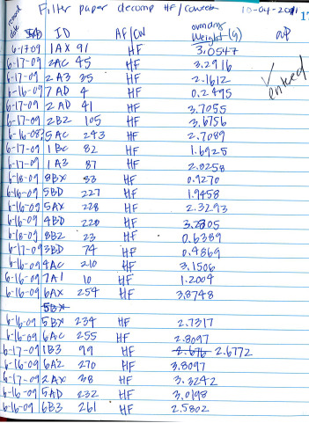
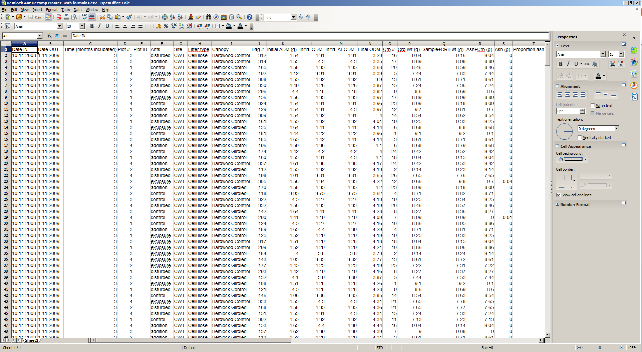
2012
2014
changes to the master.txt
Assigned 15 months to cellulose 1bx,3bx,6ad,6bd,7ac, and 3 months to cellulose 7bd with missing month value. This means each subplot is sampled in every time period.
Changed all "dc" subplots to "bc", since those were missing from all plot 5.
2008-2010

Slide 14
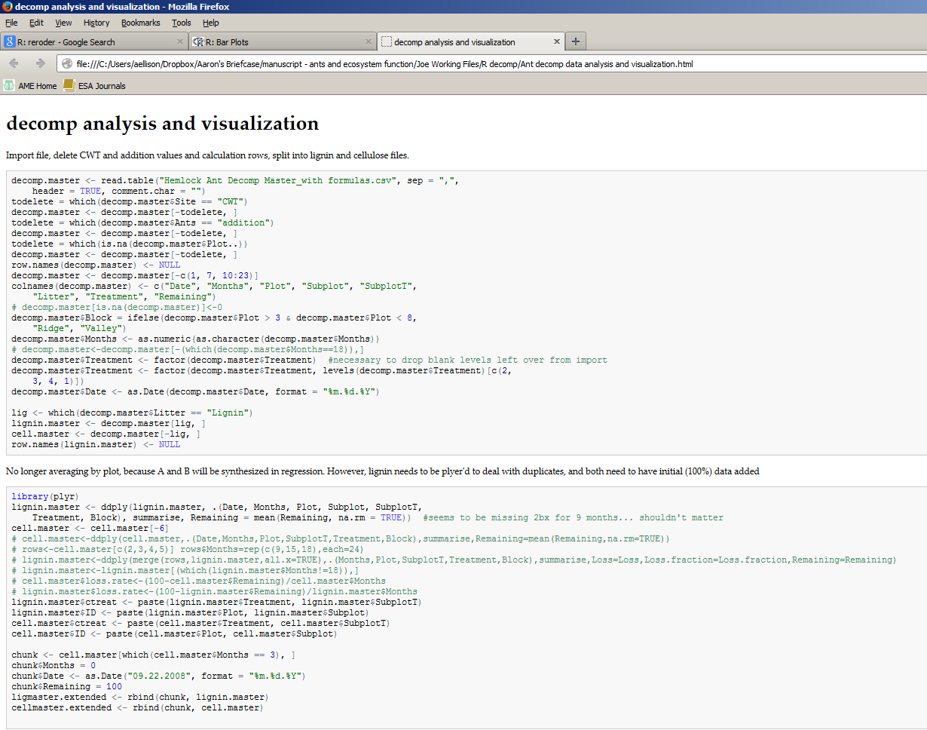

Slide 15
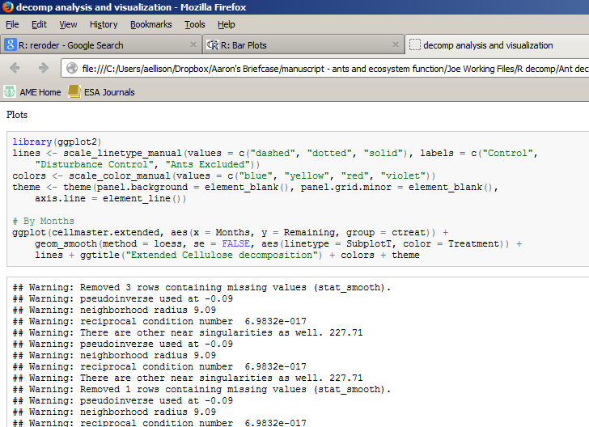

Slide 16
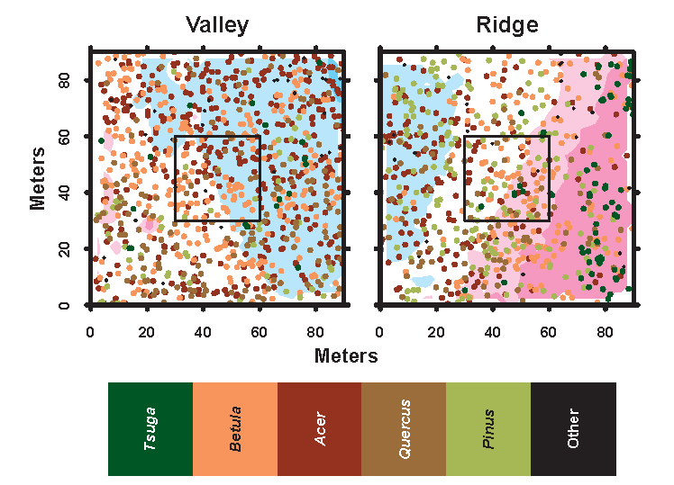

Slide 17

This happens if you use a non-standard API. You are allowed to do that, but cannot expect that it is maintained.
The C code underlying base graphics has been migrated to the graphics package (and hence no longer uses .Internal() calls).

Slide 18


Reproducible
Traceable
Usable
Comparable

Slide 19
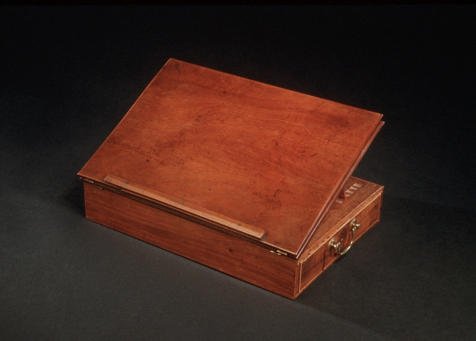

Slide 20
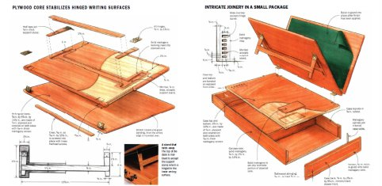
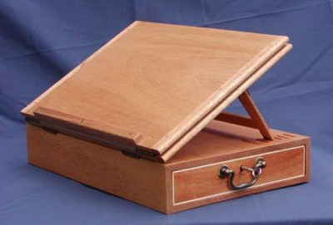
© Lon Schleining

Slide 21
